Slide 1
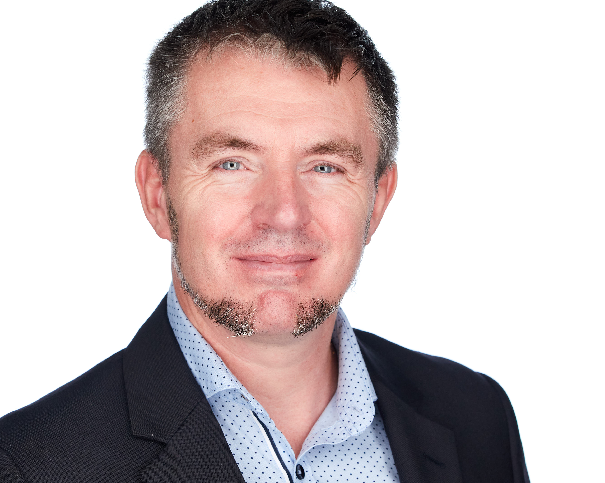





JON-PAUL BOYD
Intelligent Systems Engineer
I thrive on delivering tangible, cutting-edge, AI-enabled and analytic solutions that inform, empower & perform. I help solve business challenges and deliver value to all stakeholders through strong theory, experienced hands-on, clarity of thought and communication.
+41 (0)79 952 18 81 jp@corticalstack.ai corticalstack.ai jonpaulboyd Nyon, CH
CAREER HIGHLIGHTS
EDUCATION
STATS
SAP HANA Technical Architect
Nestle | Vevey, CH | 2014 – 2017
Technical lead, inspiring team implementing groundbreaking HANA-based analytics reporting solution. Empowered 3000 users with multi-level recipe search to answer questions of regulatory compliance, quantity & procurement previously impossible. Learned I’m still hungry for technical challenges.
Resolved SAP product shortcomings, developing tool for analytic privileges build & assign, enabling project go-live.
Quantified performance, developing tool measuring query times vs KPIs, supporting user experience/expectation mgmt.
Acquired new skillsets to configure HANA workload management, HALM & HRF, then shared with team.
Formalized Nestle HANA dev best practices.
Executed 5 HANA major upgrades & migration of analytics sidecar to embedded NetWeaver/HANA dual stack.
Liaised daily with stakeholders, technical & product teams.
SAP HANA Technical Architect
Bluefin Solutions | London, UK | 2014
Helped BAT realise Gartner’s Logical Data Warehouse concept by implementing HANA SDA for data federation of London & Sydney databases. Learned trust won on transparency & keeping delivery promises goes a long way.
Developed new P&L, achieving sub-second performance (legacy 2m10s), SAP Fiori KPI dashboard with item drill-down.
SAP HANA Technical Architect
HANA Propulsion Laboratory| Blonay, CH | 2013
Learned HANA by engineering piloted vehicle, with real time telemetry to cloud-hosted dB for analytics & vehicle control via openUI5 cockpit. Realised benefits of deep & wide research.
Developed data mining for game analytics & reward system tied to mission objectives & pilot behaviour.
SAP Web Dynpro ABAP Consultant
Nestle| Vevey, CH | 2010 – 2013
Revitalized team, solving skillset deficit, & guided complex dev, problem-solving & upgrades. Learned greater self-belief & improved interpersonal skills through learning from others.
Redesigned recipe change documents with new concept driven by simplicity, familiarity & customisation.
Cultivated offshore dev capability with technical training.
SAP ABAP Consultant
Belgian Railways| Brussels, BB | 2008 – 2010
Mobilized to successfully guide & rescue a failing technical project integrating RF scanning into warehouse management shipment handling. Learned love of OO dev & software in physical systems.
Individually responsible for complex bespoke development functionality within logistics execution.
Senior SAP ABAP Consultant
Cap Gemini| Middlesbrough, UK | 2000 – 2008
Analysed customer systems from ABAP perspective to enable the smooth transitioning into SAP competency centre flagship nearshoring service. Demonstrated technical & client-facing capability by delivering additional revenue earning on-site consultancy & training. Learned rewards of coaching juniors.
Supervised 3 ABAP developer colleagues, managing work pipeline and continuous coaching.
Innovated systems integration monitoring dashboard.
Masters Intelligent Systems
De Montfort University | UK | 2017 – 2020
Discovered why stronger partnerships should exist between enterprise and academia.
Applied Computational Intelligence (88%) Predicting customer behaviour with tree-based classifiers. Extensive Python with data profiling & preparation, unsupervised & supervised machine learning, overfitting protection, hyperparameter tuning, model scoring, evaluation & selection.
A.I. Programming (80%)
NLP Python NLTK context-free grammars for natural language to SQL database query.
Data Mining (80%)
Data analysis & machine learning to predict risk indicators for cardiovascular disease.
Neural Networks (80%)
Evaluation of biomass & classification of network activity (intrusion, attack, normal).
Fuzzy Logic (94%)
Classifying breast cancer tumours with fuzzy inference, outperforming neural networks. Authored paper submitted to journal Applied Soft Computing for publication.
Research Methods (96%)
PhD proposal for augmented analytics.
Mobile Robots (97%)
Virtual search & rescue robot controlled via Python, implementing obstacle avoidance, sensor data fusion, environment mapping, precision navigation, victim location.
Computational Intelligence Optimization (100%) Design & build of Python-based hyper-heuristic optimization platform to address the real-world problem of scheduling optimisation. 5 example nature-inspired metaheuristic algorithms are implemented. A hyper-heuristic feature dynamically switches between low-level metaheuristics to deterministically use the most appropriate algorithm according to current problem state, or select one stochastically.
Masters Project In Progress
Building cloud-hosted medical research cockpit for knowledge discovery, summarization, topic classification & clustering for best-informed next stage research actions, using COVID-19 literature.
23
LinkedIn Recommendations
25
Years software dev
5
Years HANA dev
36
Companies provided expertise
35
GitHub Repos
8
Masters modules graded distinction
12
Times consulting contract extended
1
Individual delivering client centric excellence
TOOLS
Python
Pandas
Numpy
Scikit-Learn
Keras
NLTK
Elasticsearch MongoDB
SAP HANA
SAP ABAP
SAP Security
ReactJS
JavaScript
Amazon AWS
MS Azure
Docker
Git
GitLab
Linux
Windows 10
PRAISE
“Tech savvy, experienced, meticulous, dependable, ingenious & eager to learn more”
Rudi Dutli, Principal, Infosys Lodestone
“Builds comprehensive understanding of architectures involved, educating & inspiring teams & co-workers in the process. A real flair for challenging, on-the-edge development”
Trond Stroemme, Team Lead, SAP App Expertise Centre, Nestle
“An expert in his domain, a great team player. His focus on results with optimal quality is outstanding”
Norbert Rignall, Master Data Solution Architect, Nestle
AWARDS
Microsoft Certified Azure Fundamentals
AWS Certified Cloud Practitioner

